Slide 1



September
2025
www.chiroonpurpose.com

Slide 2



Children’s Health Trends
U.S. child mortality is improving, but chronic conditions and obesity remain stubbornly high, an urgent call to action for all healthcare providers.
Forrest CB, Koenigsberg LJ, Harvey FE, Maltenfort MG, Halfon N. Trends in US children’s mortality, chronic conditions, obesity, functional status, and symptoms. JAMA. 2025;334(6):509-516. doi:10.1001/jama.2025.9855.
WWW.CHIROONPURPOSE.COM

Slide 3
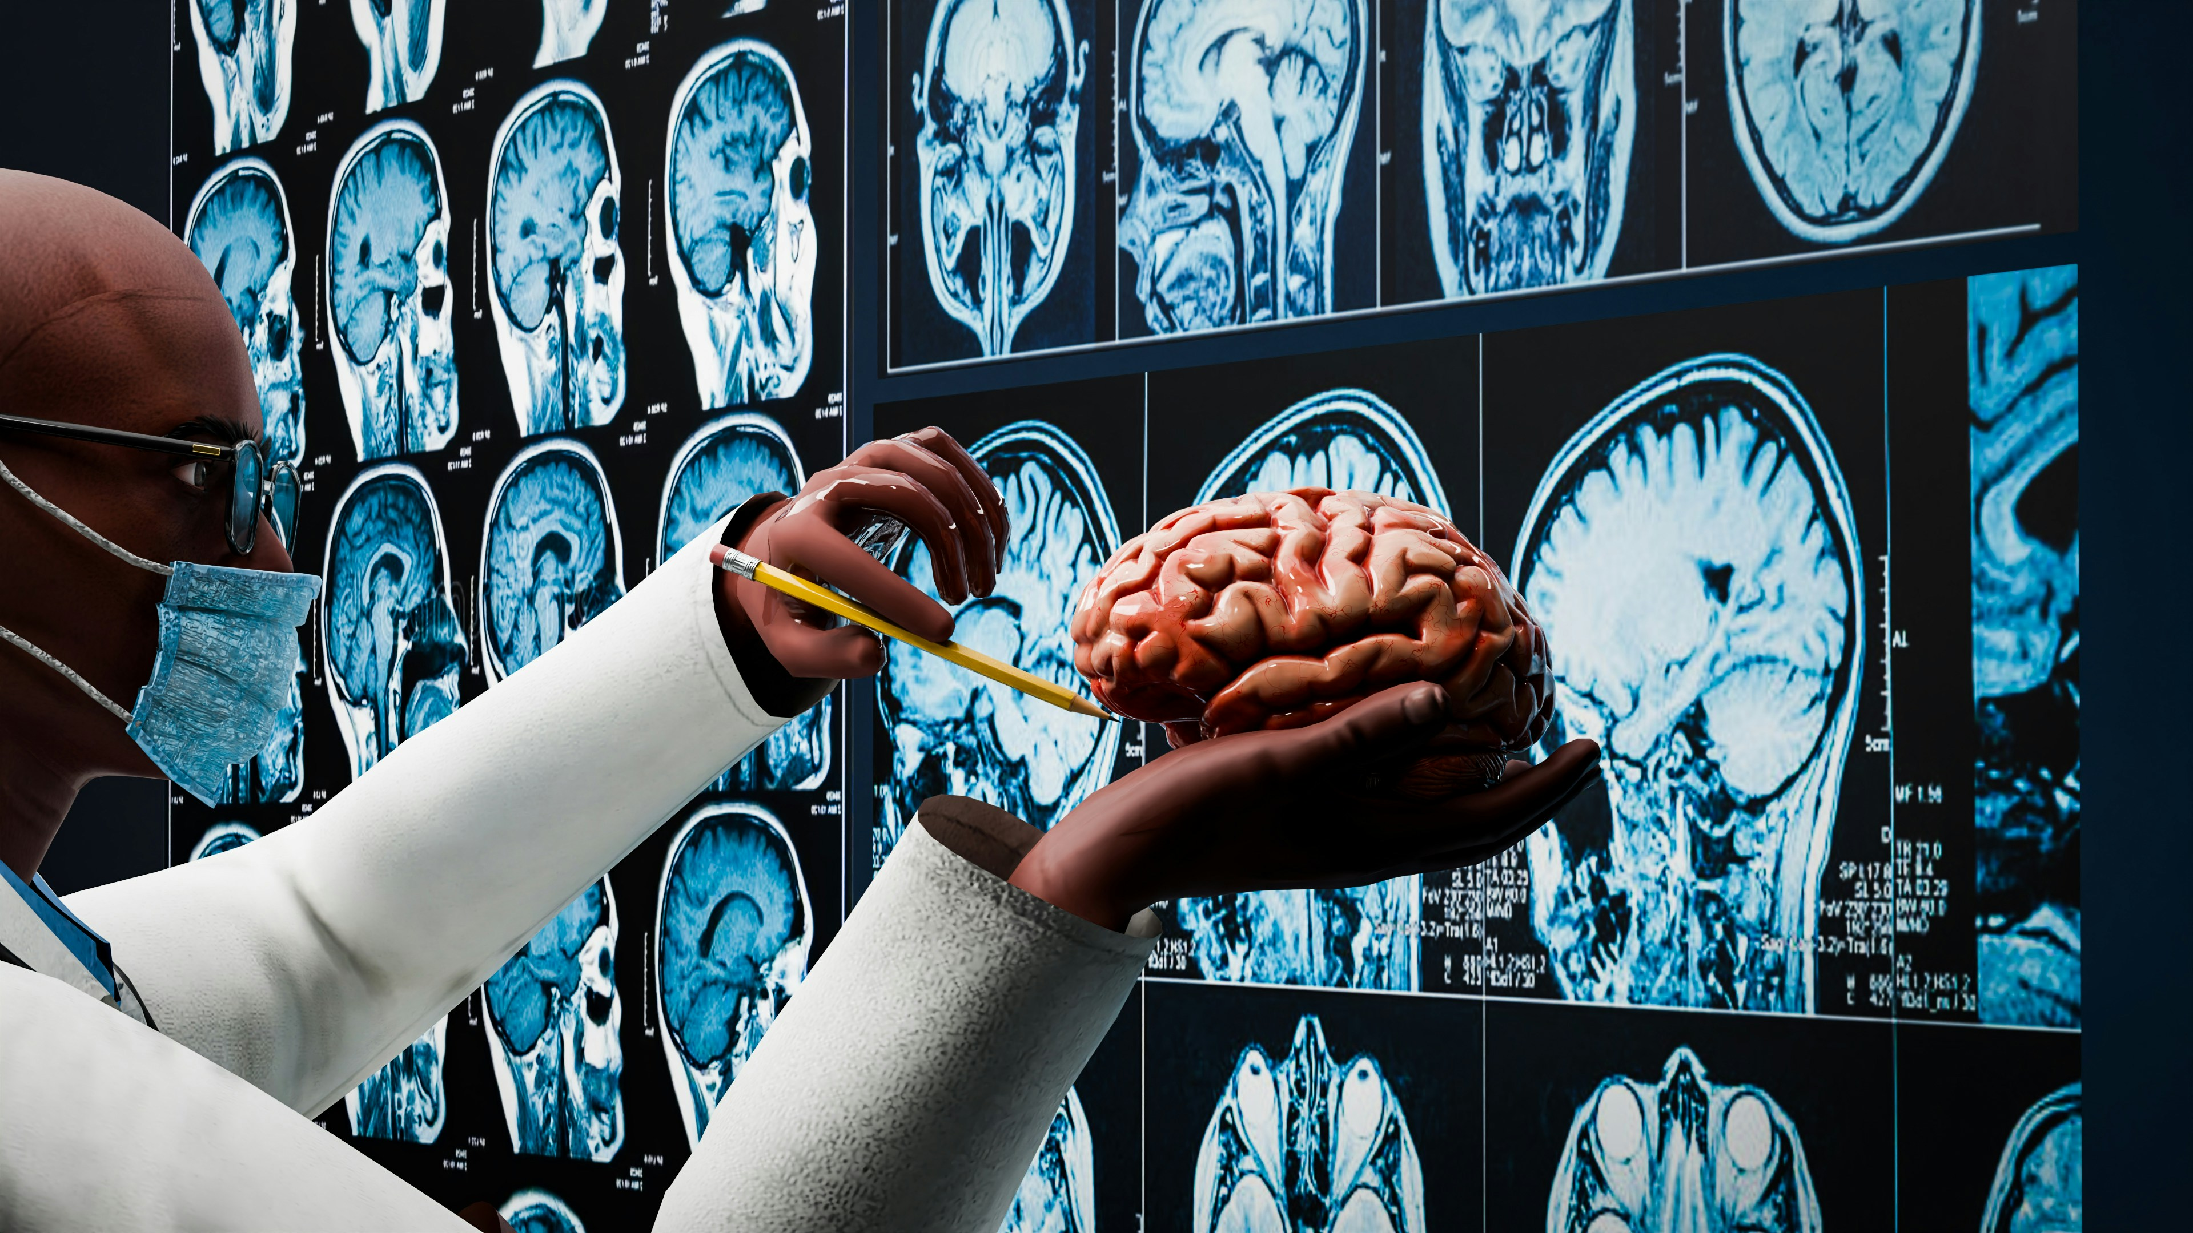
Brains That Keep Growing
Researchers have now proven that the adult brain continues to generate new neurons well into the senior years, reshaping how we think about memory and healing.
Bradford N. Proof that adult brains make new neurons settles scientific controversy. Sci Am. 2025 Jul 3.
WWW.CHIROONPURPOSE.COM

Slide 4
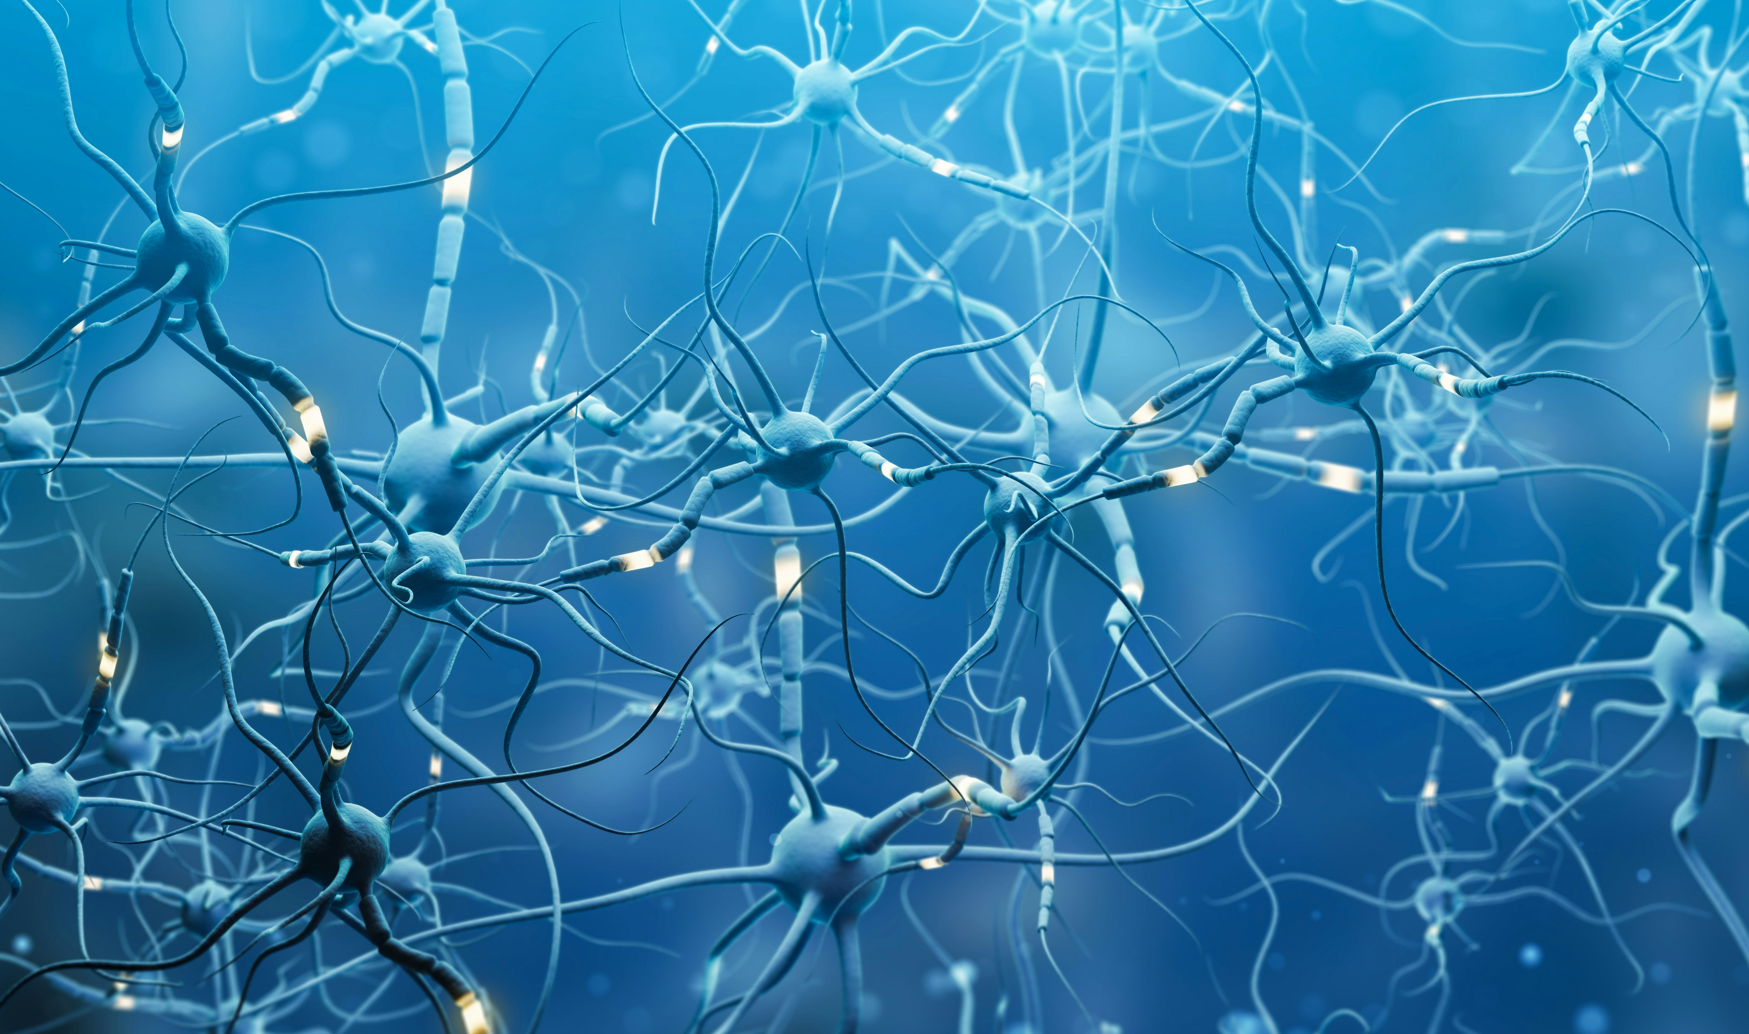
Mapping Hidden Neurogenesis
Using cutting-edge single-cell sequencing and spatial mapping, scientists traced every stage of newborn neurons in adults up to 78 years old.
Dumitru I, et al. Identification of proliferating neural progenitors in the adult human hippocampus. Science. 2025;389:58-63. doi:10.1126/science.adu9575.
WWW.CHIROONPURPOSE.COM

Slide 5

Plasticity Without Age Limits
Even a small number of newly generated hippocampal cells can meaningfully influence memory and mood, proof the brain’s plasticity never stops.
Dumitru I, et al. Science. 2025;389:58-63.
WWW.CHIROONPURPOSE.COM

Slide 6
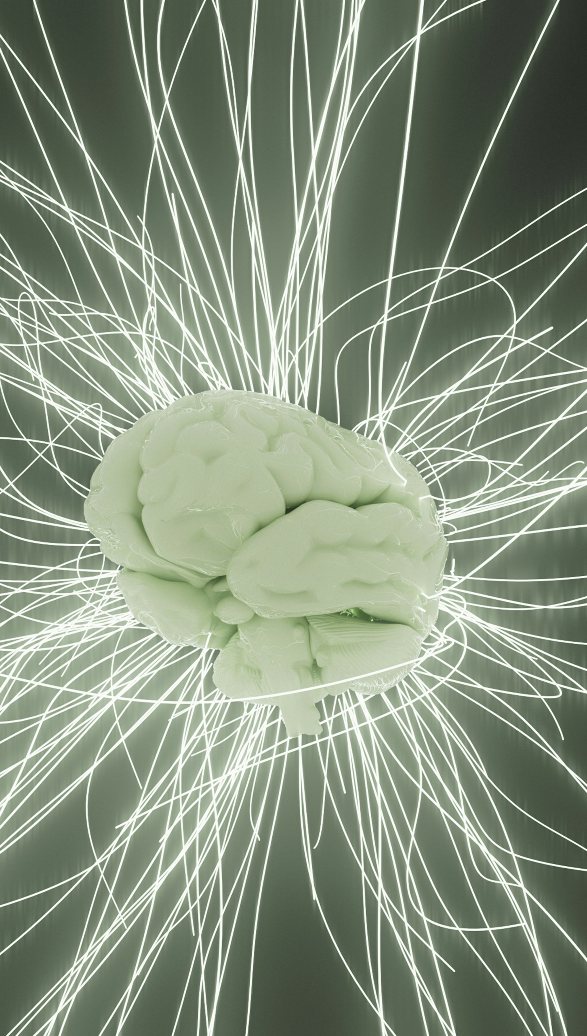
New Neurons at 78
“Scientists have found newly formed neurons in the brains of adults as old as age 78, and, for the first time, have identified the other brain cells that birthed them.”
Bradford N. Sci Am. 2025 Jul 3.
WWW.CHIROONPURPOSE.COM

Slide 7
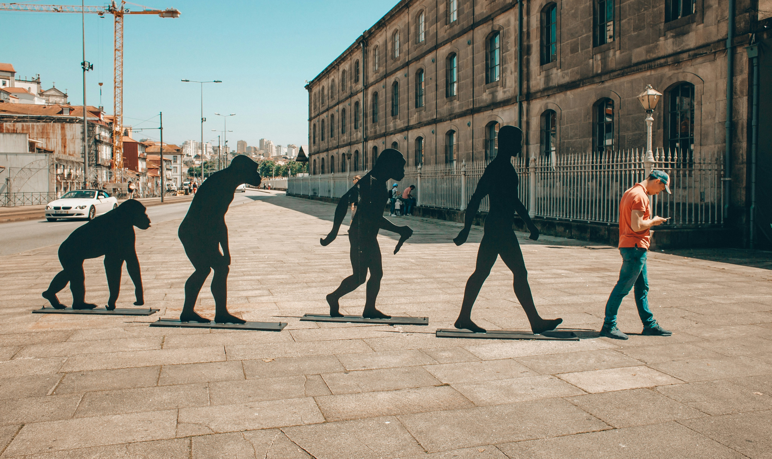
The Whole Process Is There
Now we have very strong evidence that the whole process is there in humans, from the precursor cells to the immature neurons.
Bradford N. Sci Am. 2025 Jul 3.
WWW.CHIROONPURPOSE.COM

Slide 8
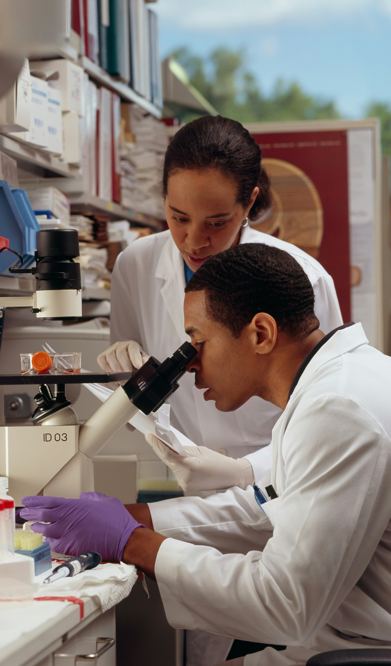
Pathway to Healing Disorders
“Learning more about how neurogenesis happens, and whether the process can be altered, could prove helpful for understanding a range of disorders and diseases.”
Bradford N. Sci Am. 2025 Jul 3.
WWW.CHIROONPURPOSE.COM

Slide 9

Neurogenesis Fuels Memory & Mood
Continuous adult hippocampal neurogenesis is involved in memory formation and mood regulation but is challenging to study in humans.
Dumitru I, et al. Science. 2025;389:58-63. doi:10.1126/science.adu9575.
WWW.CHIROONPURPOSE.COM

Slide 10
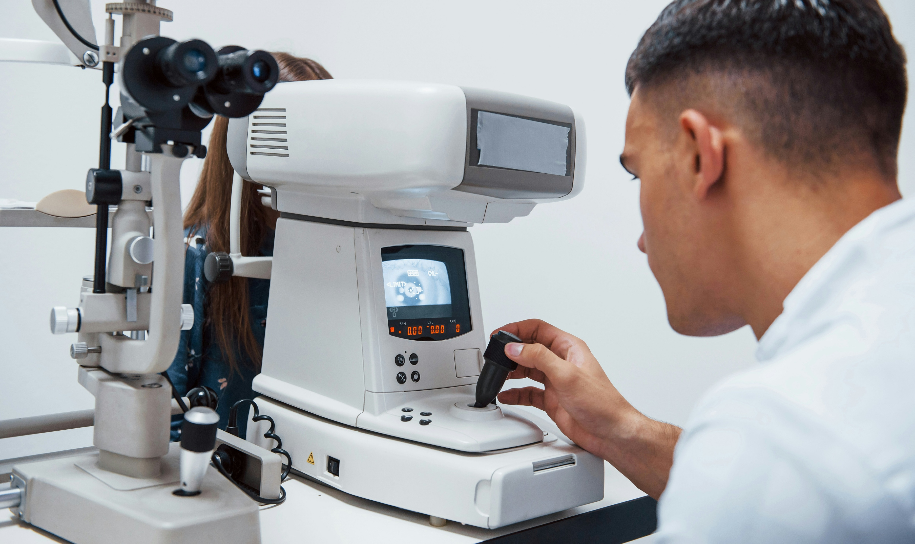
Cellular Proof
The identification of a neurogenic cell trajectory with proliferating neural progenitor cells provides a cellular underpinning for the mitotic generation of neurons in the adult human hippocampus.
Dumitru I, et al. Science. 2025;389:58-63.
WWW.CHIROONPURPOSE.COM

Slide 11
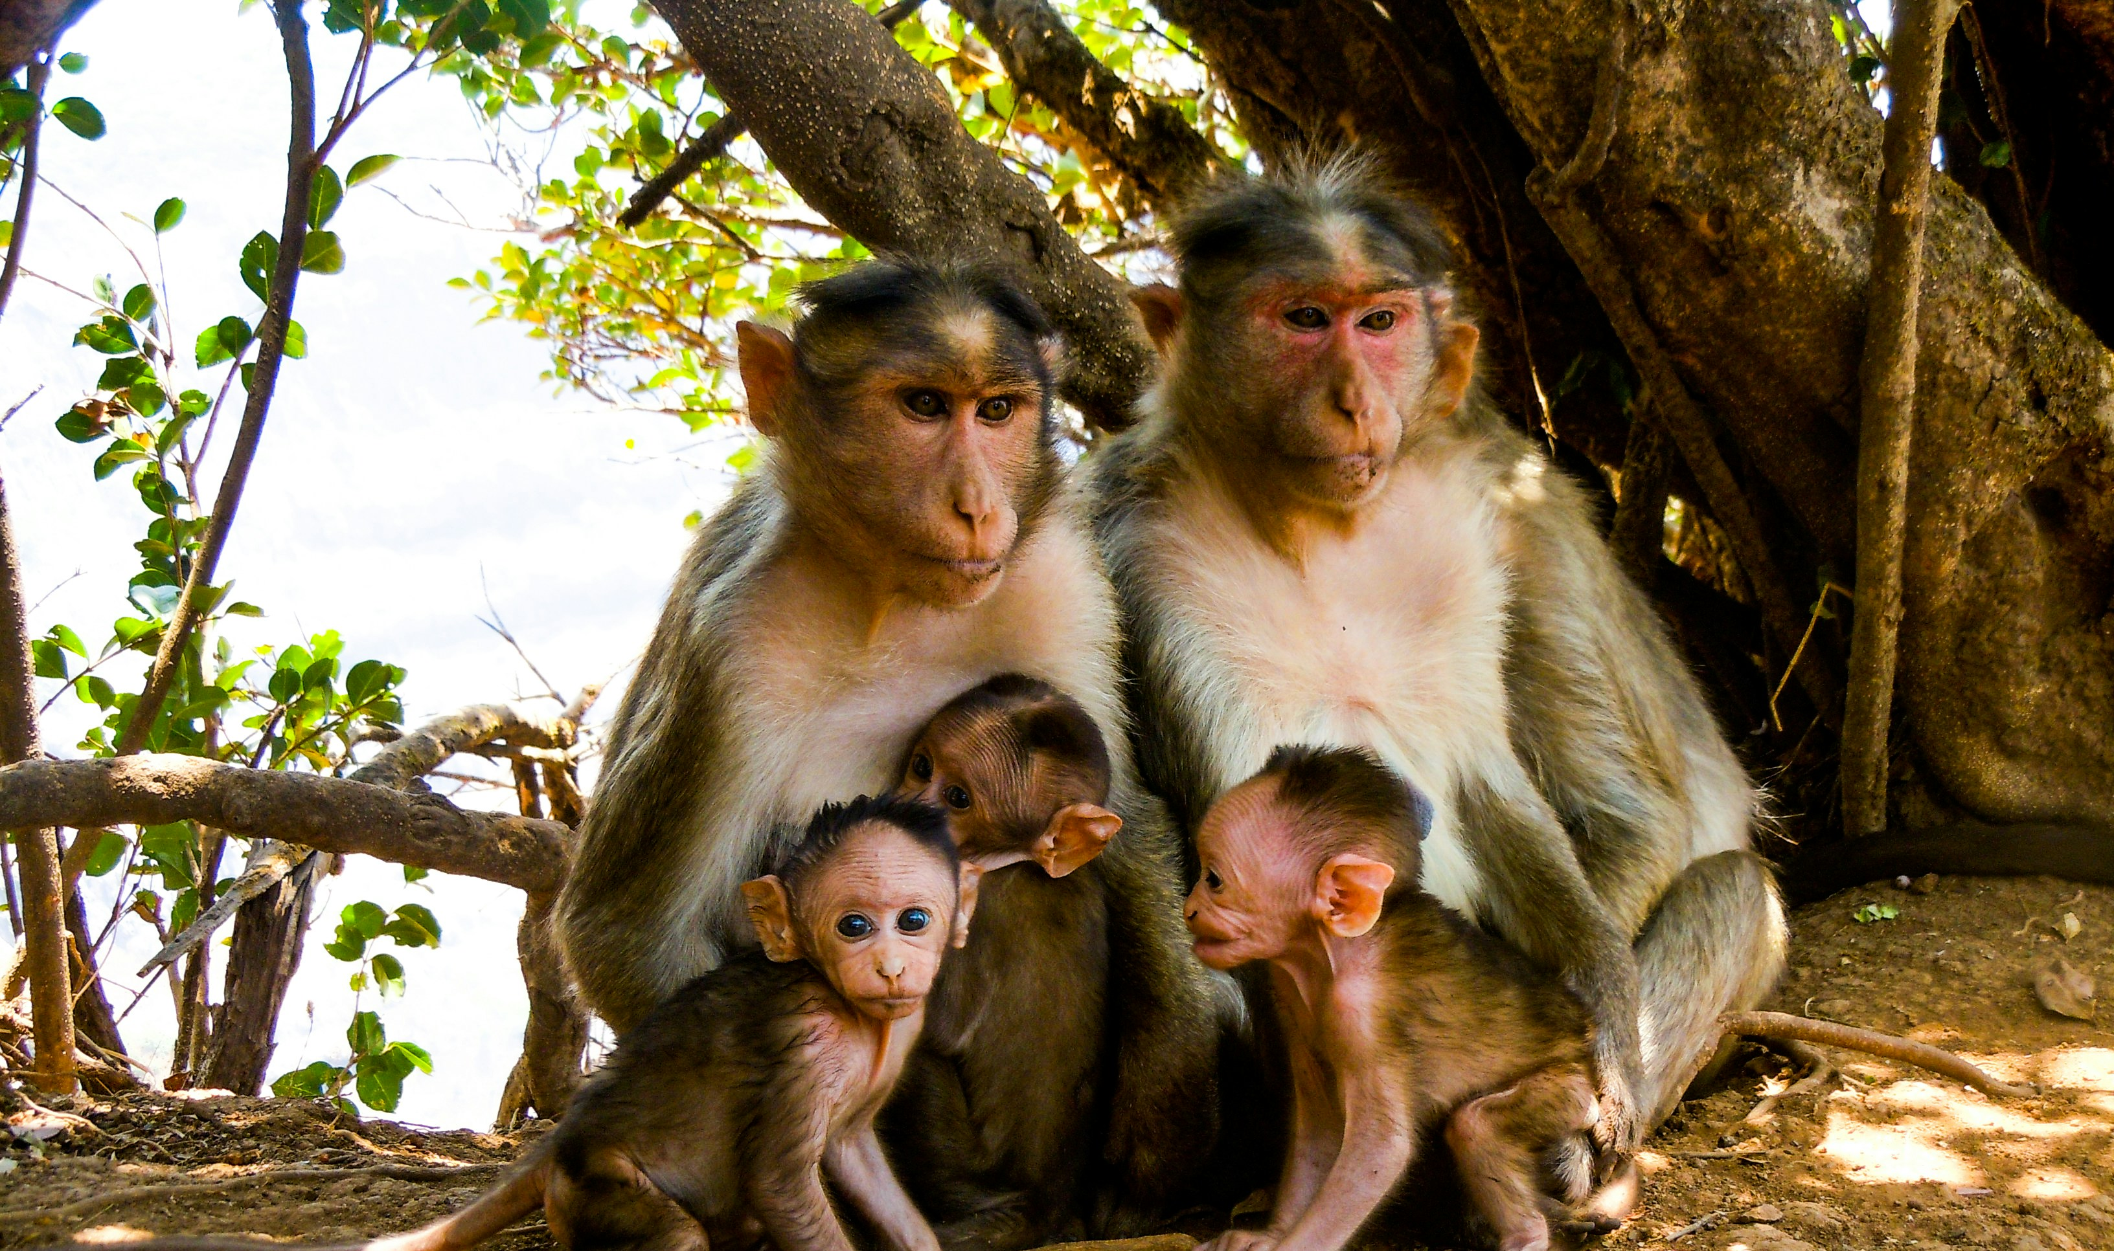
Shared Across Species
Adult human neural progenitors are transcriptionally similar to those in mice, pigs, macaques, and in humans during childhood.
Dumitru I, et al. Science. 2025;389:58-63
WWW.CHIROONPURPOSE.COM

Slide 12

Gateway of the Hippocampus
The dentate gyrus is the primary gateway of the hippocampus, controlling how information flows from the cortex to the hippocampus proper.
Dumitru I, et al. Science. 2025;389:58-63
WWW.CHIROONPURPOSE.COM

Slide 13
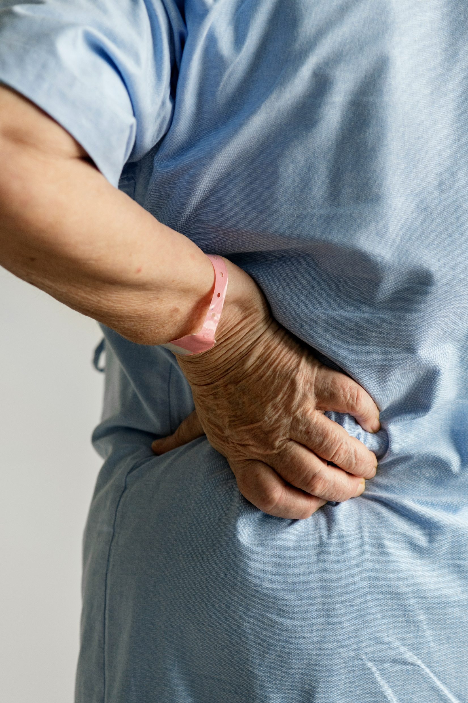
A Simple Spit Test
A simple saliva sample can reveal inflammatory markers tied to chronic low-back pain, opening the door to easier monitoring of treatment results.
Injeyan HS, et al. Salivary biomarkers of inflammation in patients with chronic non-specific low back pain. Biomark Insights. 2025;20:1-11. doi:10.1177/11772719251355038.
WWW.CHIROONPURPOSE.COM

Slide 14

Inflammation Mirrors Pain
Key inflammatory cytokines in saliva—IL-1β, IL-6, IL-8, and MCP-1—rise in step with reported pain levels, offering a measurable window into patient discomfort.
Injeyan HS, et al. Biomark Insights. 2025;20:1-11
WWW.CHIROONPURPOSE.COM

Slide 15

Saliva Speaks
Saliva represents a viable medium for assessing key inflammatory biomarkers in patients with chronic non-specific low back pain.
Injeyan HS, et al. Biomark Insights. 2025;20:1-11
WWW.CHIROONPURPOSE.COM

Slide 16

Tracking Progress Over Time
Future studies utilizing unstimulated saliva samples may further investigate changes in inflammatory biomarker levels to monitor treatment outcomes.
Injeyan HS, et al. Salivary biomarkers of inflammation in patients with chronic non-specific low back pain. Biomarker Insights. 2025;20:1-11. doi:10.1177/11772719251355038
WWW.CHIROONPURPOSE.COM

Slide 17

Blood Evidence of Inflammation
Elevated inflammatory mediators have been detected in blood samples of patients with non-specific low back pain, suggesting an inflammatory component to the condition.
Injeyan HS, et al. Biomark Insights. 2025;20:1-11
WWW.CHIROONPURPOSE.COM

Slide 18
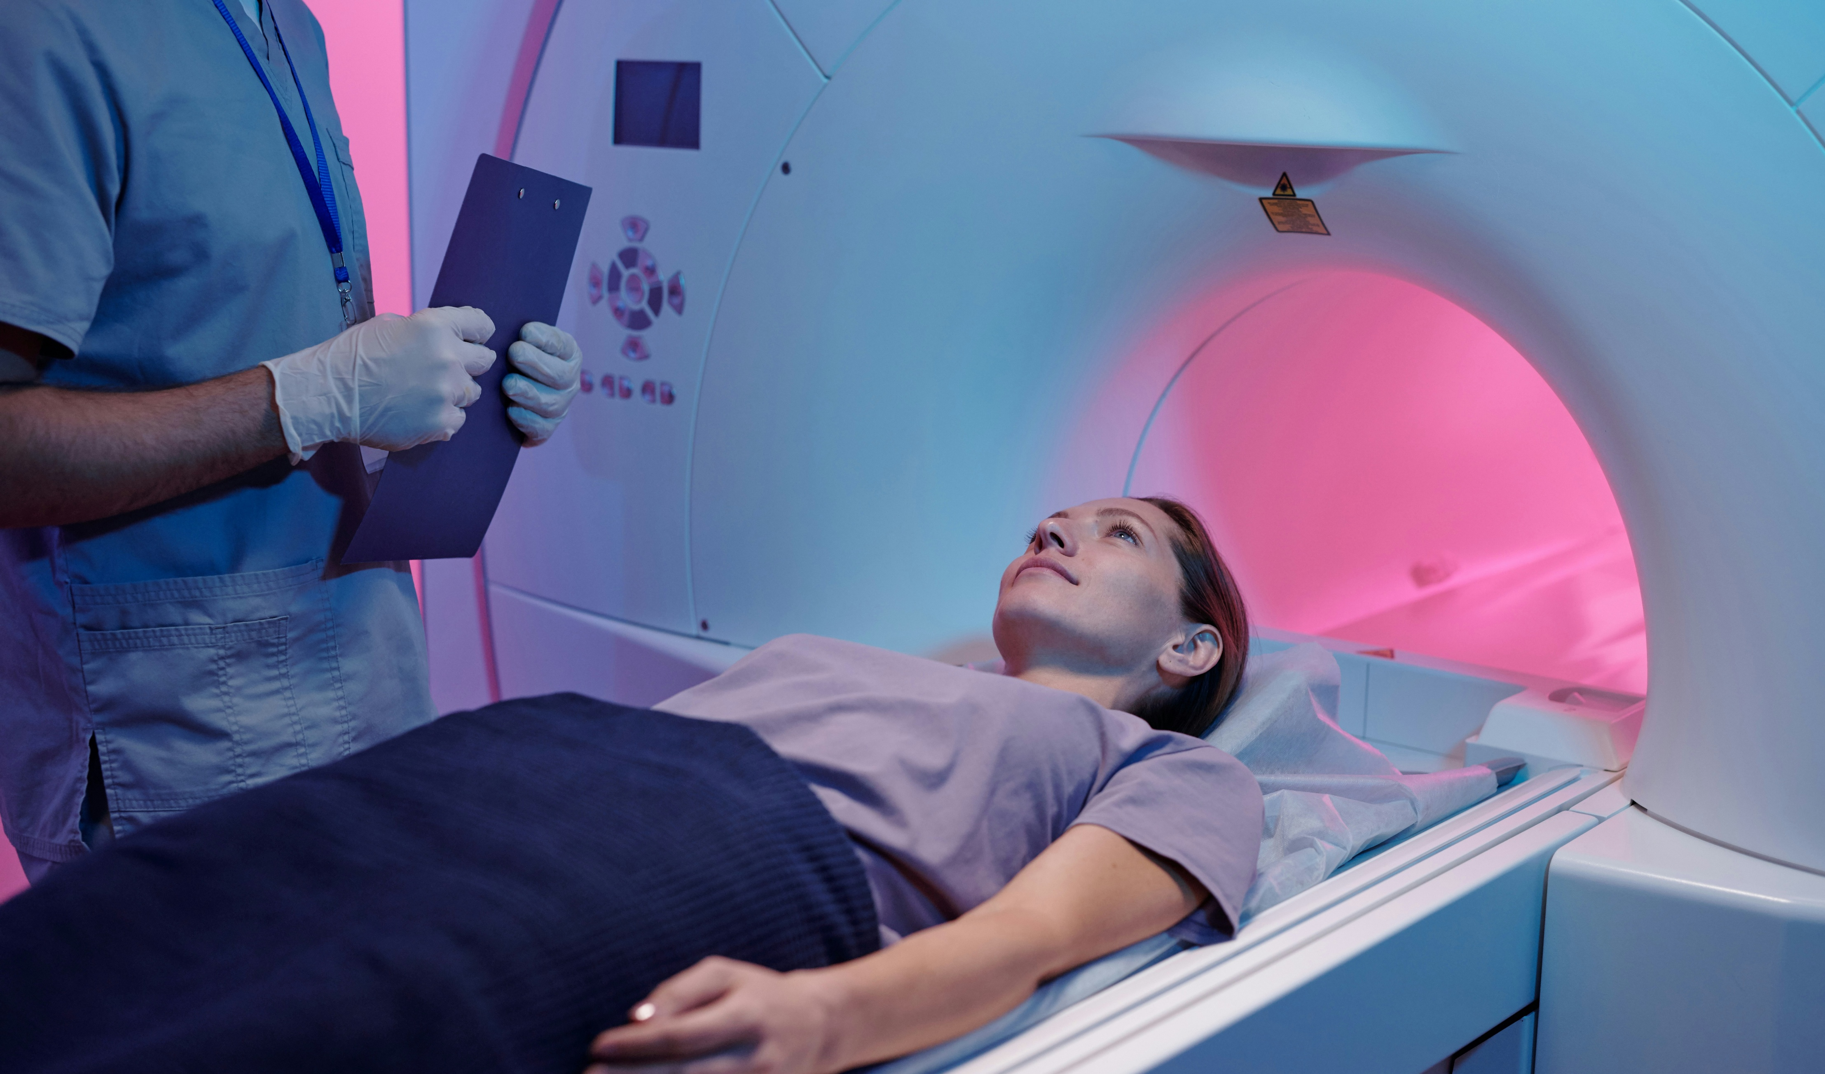
When MRI Misses
Dynamic imaging can reveal cervical spine injuries that standard MRI misses, transforming both clinical care and medico-legal evaluations.
Vernon LF, Benn A. Documenting cervical spine injuries following negative MRI findings: clinical and medico-legal overview of dynamic imaging. Cureus. 2025;17(7):e88121. doi:10.7759/cureus.88121
WWW.CHIROONPURPOSE.COM

Slide 19

Advocacy Through Imaging
The ability to document hidden cervical injuries carries profound implications for patient advocacy and legal protection.
Vernon LF, Benn A. Cureus. 2025;17(7):e88121
WWW.CHIROONPURPOSE.COM

