Slide 1



May
2025
www.chiroonpurpose.com

Slide 2



Beyond Backs: Brain-Body Balance
Chiropractic care goes deeper than posture — it enhances how the brain and body communicate, especially vital in a child’s early development.
Kent C, McCoy M. On Purpose Science. May 2025. Available from: https://www.chiroonpurpose.com/
WWW.CHIROONPURPOSE.COM

Slide 3

Neurology in Motion
The spine isn’t just structure — it’s the highway for nervous system signals. Adjustments help the brain and body stay in sync, improving focus, coordination, and resilience.
Kent C, McCoy M. On Purpose Science. May 2025. Available from: https://www.chiroonpurpose.com/
WWW.CHIROONPURPOSE.COM

Slide 4

No Placebo Can Do This
Better balance, clearer speech, improved motor control — these aren’t imagined. The changes observed in kids after care are measurable and meaningful.
Kent C, McCoy M. On Purpose Science. May 2025. Available from: https://www.chiroonpurpose.com/
WWW.CHIROONPURPOSE.COM

Slide 5

Align the Body. Unlock the Brain
From posture to proprioception, every adjustment influences how children move, learn, and grow. Alignment is the access point to higher function.
Kent C, McCoy M. On Purpose Science. May 2025. Available from: https://www.chiroonpurpose.com/
WWW.CHIROONPURPOSE.COM

Slide 6

Adjust to Awaken
A well-adjusted spine supports a stronger immune system—yes, even in animals.
Kent C, McCoy M. On Purpose Science. May 2025. Available from: https://www.chiroonpurpose.com/
WWW.CHIROONPURPOSE.COM

Slide 7

Ancient Wisdom, Modern Science
Chiropractic bridges timeless truths with contemporary research, reminding us that healing is both an art and a science.
Kent C, McCoy M. On Purpose Science. May 2025. Available from: https://www.chiroonpurpose.com/
WWW.CHIROONPURPOSE.COM

Slide 8

More Than a Career — a Calling
From the first adjustment to advanced degrees, the chiropractic journey is fueled by purpose, not just profession.
Kent C, McCoy M. On Purpose Science. May 2025. Available from: https://www.chiroonpurpose.com/
WWW.CHIROONPURPOSE.COM

Slide 9
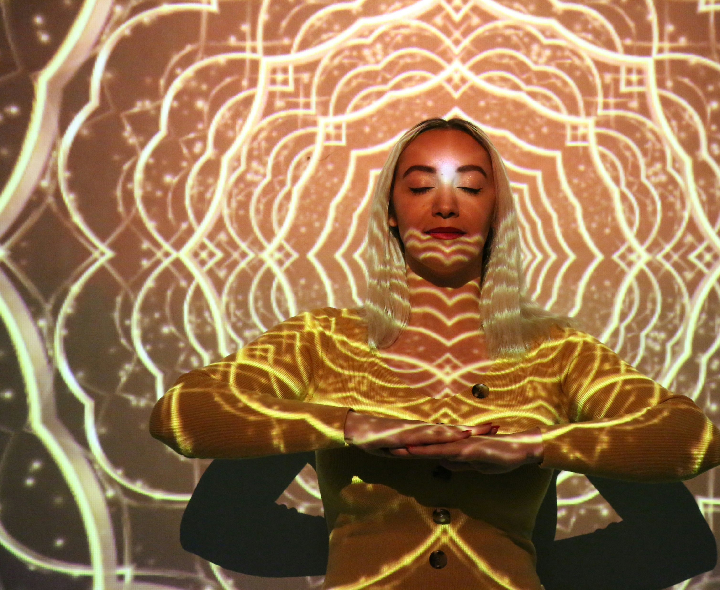
Vitalism:
The Missing Link
Innate intelligence isn’t outdated — it’s essential. True healing begins when we acknowledge the body’s natural wisdom.
Kent C, McCoy M. On Purpose Science. May 2025. Available from: https://www.chiroonpurpose.com/
WWW.CHIROONPURPOSE.COM

Slide 10

Break the Monopoly
Student debt should fund education — not entrench power. The chiropractic cartel must be challenged for the profession to grow.
Kent C, McCoy M. On Purpose Science. May 2025. Available from: https://www.chiroonpurpose.com/
WWW.CHIROONPURPOSE.COM

Slide 11

Stop Weaponizing Accreditation
When gatekeeping overrides fairness, innovation suffers. Accreditation should ensure quality — not control.
Kent C, McCoy M. On Purpose Science. May 2025. Available from https://www.chiroonpurpose.com/
WWW.CHIROONPURPOSE.COM

Slide 12

Time to Adjust the System
Chiropractic education is overdue for reform. High cost, limited access, and outdated structures must evolve to serve future doctors.
Kent C, McCoy M. On Purpose Science. May 2025. Available from: https://www.chiroonpurpose.com/
WWW.CHIROONPURPOSE.COM

Slide 13

Diversity = Strength
No single group should define the profession. More voices, more viewpoints, and more vitality are the future of chiropractic.
Kent C, McCoy M. On Purpose Science. May 2025. Available from: https://www.chiroonpurpose.com/
WWW.CHIROONPURPOSE.COM

