Slide 1



June
2025
www.chiroonpurpose.com

Slide 2



In a remarkable turn of events, Kathy Reagan Young—diagnosed with multiple sclerosis—can now go about her day after UV light therapy:
That Young can have an ordinary day is remarkable.
Jacobsen R. Can Sunlight Cure Disease? Sci Am. 2025 Jun;332(6):22-31
WWW.CHIROONPURPOSE.COM

Slide 3
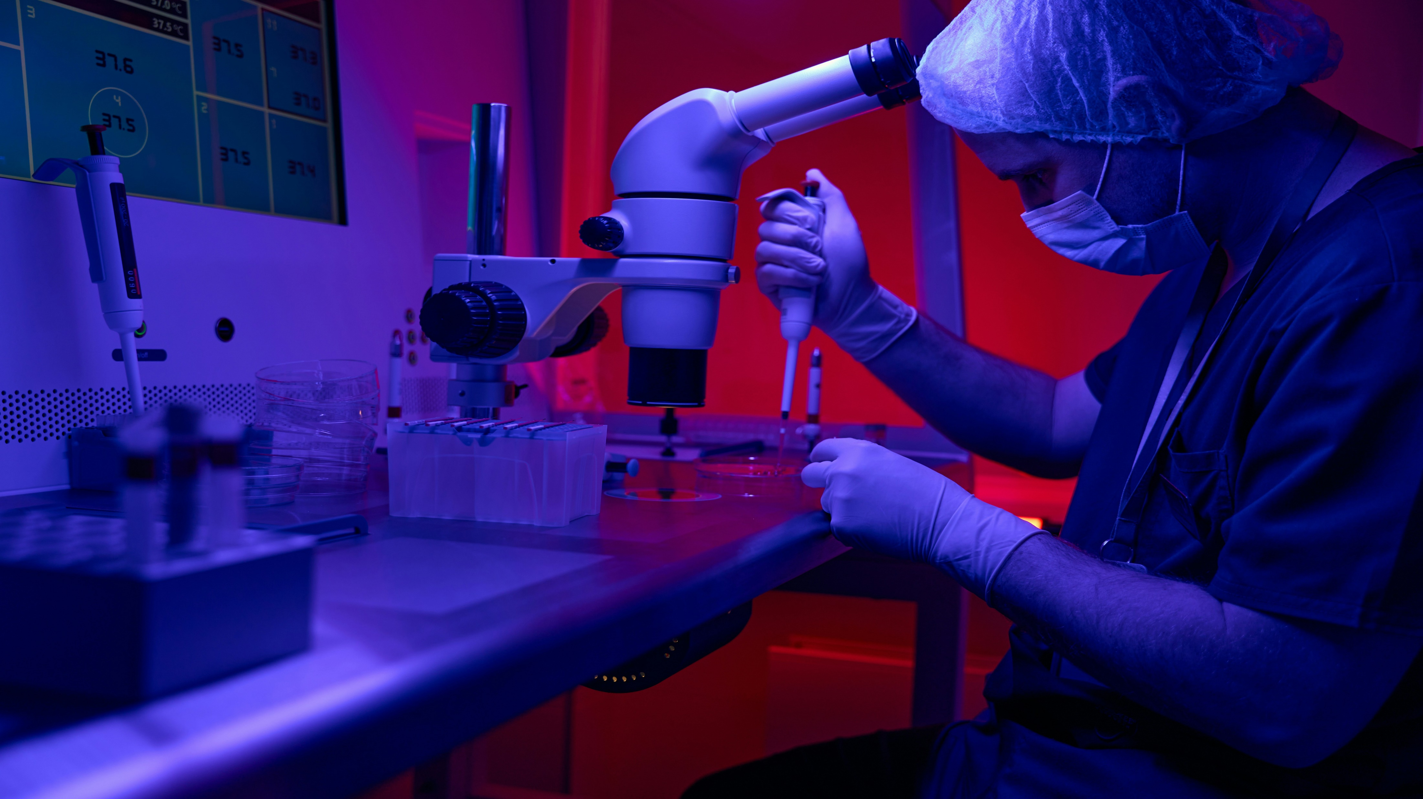
Used for years in dermatology, ultraviolet light therapy is now being explored for neurological disorders:
Ultraviolet light boxes... have been used for years in the treatment of psoriasis.
Jacobsen R. Sci Am. 2025 Jun;332(6):22-31
WWW.CHIROONPURPOSE.COM

Slide 4

Highlighting new directions in treatment:
Sunshine may hold healing rays for a variety of autoimmune diseases such as multiple sclerosis.
Jacobsen R. Sci Am. 2025 Jun;332(6):22-31
WWW.CHIROONPURPOSE.COM

Slide 5

Sunlight as Hope for chronic disease sufferers is emerging:
Scientists are turning this surprising discovery into treatments.
Jacobsen R. Sci Am. 2025 Jun;332(6):22-31
WWW.CHIROONPURPOSE.COM

Slide 6

Picard reframes cellular biology:
Mitochondria are more than powerhouses—they’re the motherboard of the cell.
Picard M. The Social Lives of Mitochondria. Sci Am. 2025 Jun;332(6):50-61
WWW.CHIROONPURPOSE.COM

Slide 7

Mitochondria & the mind-body connection
When these energy-giving organelles thrive, so do we.
Picard M. Sci Am. 2025 Jun;332(6):50-61
WWW.CHIROONPURPOSE.COM

Slide 8

Describing a hidden cellular network
Each mitochondrion hosts intricate conversations with its neighbors through molecular signals.
Picard M. Sci Am. 2025 Jun;332(6):50-61
WWW.CHIROONPURPOSE.COM

Slide 9

Chronic stress doesn’t just affect your mood—it breaks you down at a cellular level
Chronic stress breaks down mitochondrial networks.
Picard M. Sci Am. 2025 Jun;332(6):50-61
WWW.CHIROONPURPOSE.COM

Slide 10

Your biology is listening
Mitochondria adapt in real-time to our thoughts, emotions, and behaviors.
Picard M. Sci Am. 2025 Jun;332(6):50-61
WWW.CHIROONPURPOSE.COM

Slide 11

Defining chiropractic’s central concept
Vertebral subluxation is a misalignment of the spine affecting biomechanical and neurological function.
Kwon C, Binongo JN, McCoy M. Cureus. 2023 Nov 13;15(11):e48755
WWW.CHIROONPURPOSE.COM

Slide 12
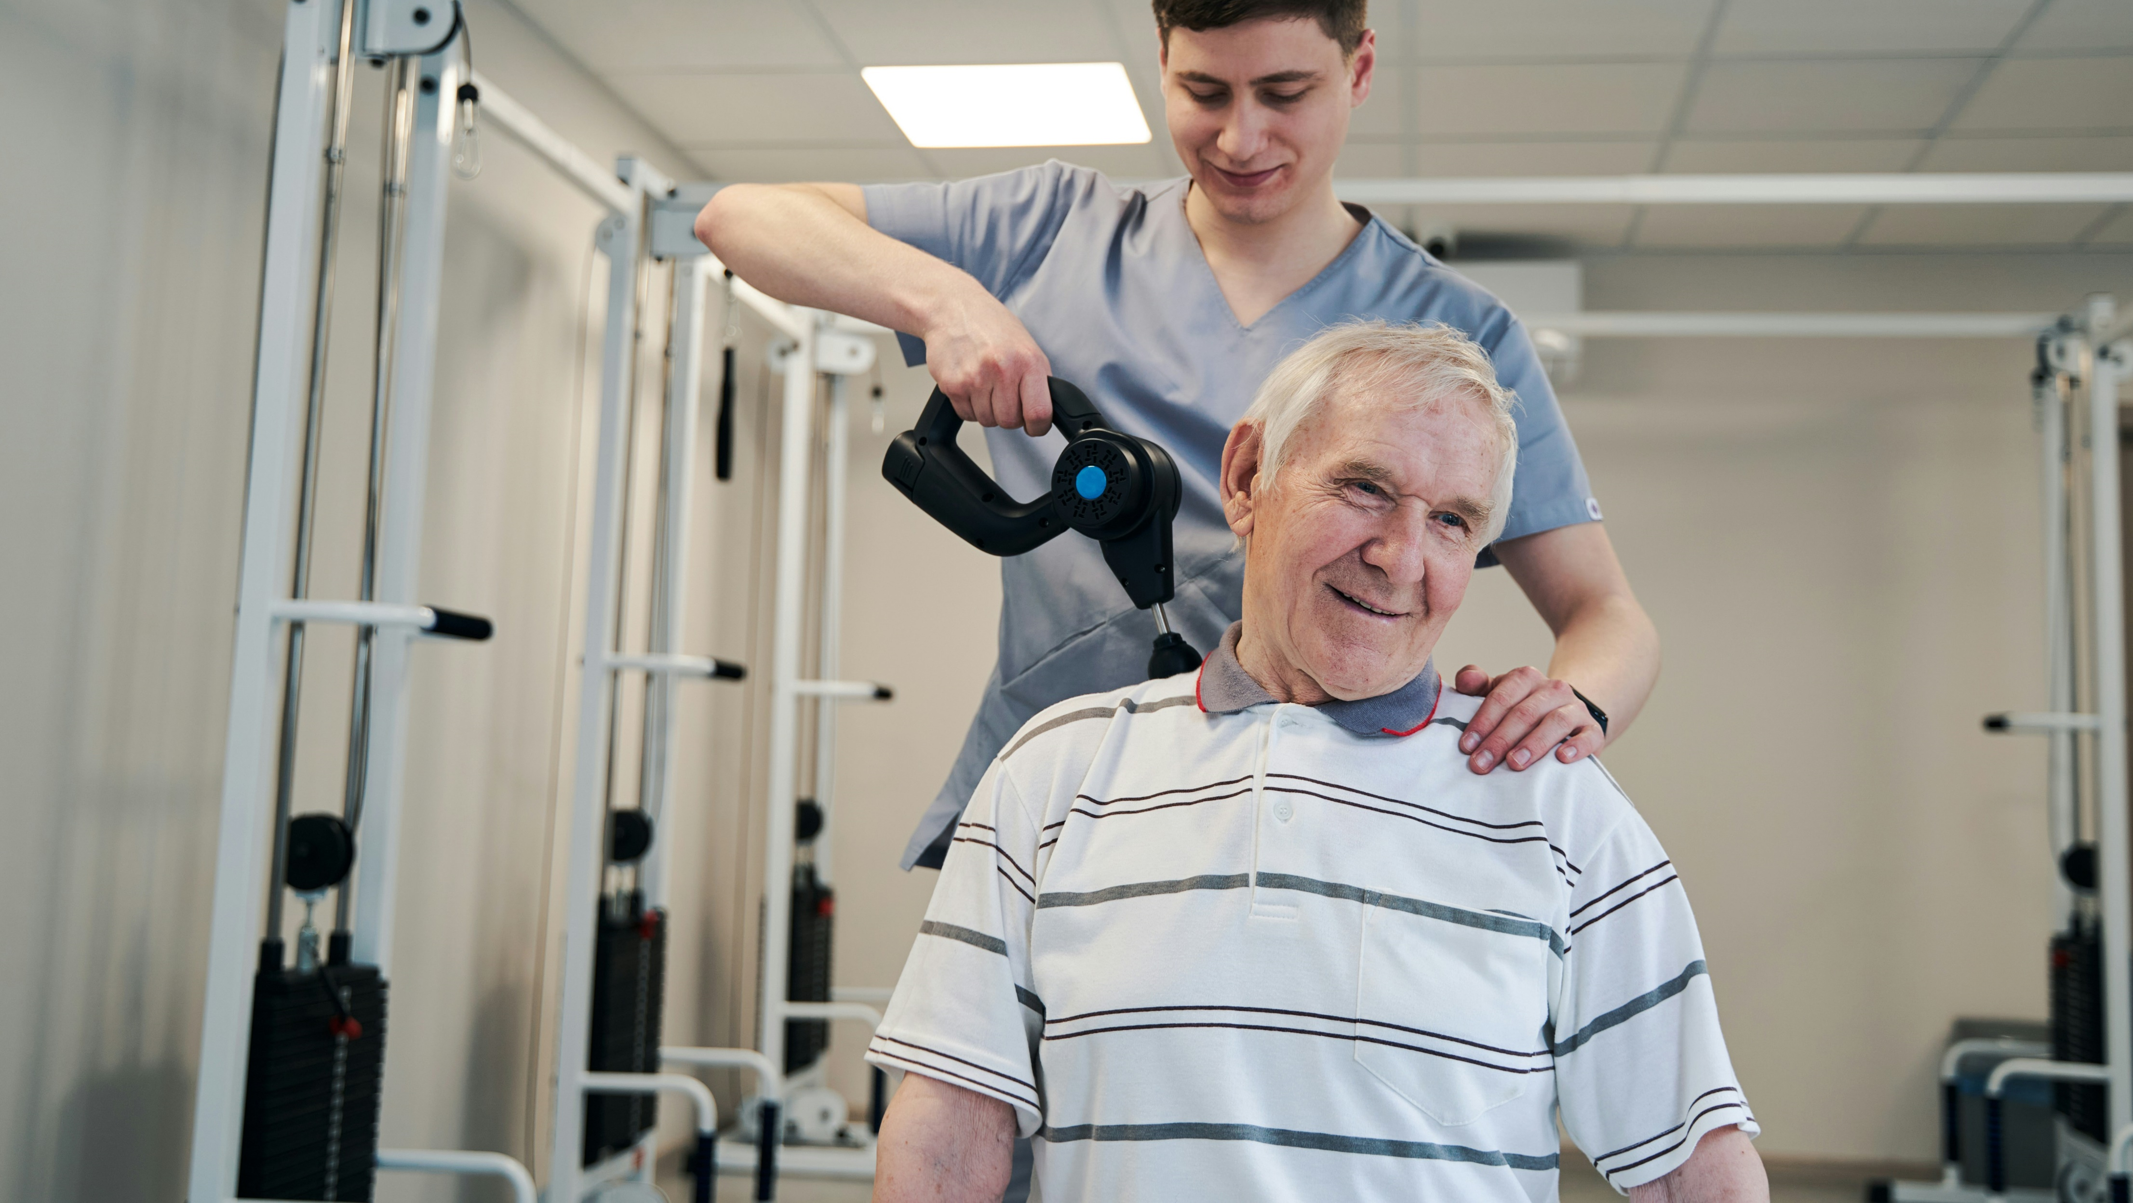
Why chiropractors adjust
The identification and correction of vertebral subluxation is the primary focus of the chiropractic profession.
Kwon C, et al. Cureus. 2023 Nov;15(11):e48755
WWW.CHIROONPURPOSE.COM

Slide 13

In their study, Kwon et al. found
This study estimated a prevalence of vertebral subluxation in over 80% of subjects seeking chiropractic care.
Kwon C, et al. Cureus. 2023 Nov;15(11):e48755
WWW.CHIROONPURPOSE.COM

Slide 14

More than just pain relief
Vertebral subluxation may contribute to reduced health adaptability and resilience.
Kwon C, et al. Cureus. 2023 Nov;15(11):e48755
WWW.CHIROONPURPOSE.COM

Slide 15

Prevention, not just treatment
The correction of vertebral subluxation may have implications for health promotion and disease prevention.
Kwon C, et al. Cureus. 2023 Nov;15(11):e48755
WWW.CHIROONPURPOSE.COM

Slide 16

A call to action for public health
Findings suggest that addressing subluxation could impact public health outcomes.
Kwon C, et al. Cureus. 2023 Nov;15(11):e48755
WWW.CHIROONPURPOSE.COM

Slide 17
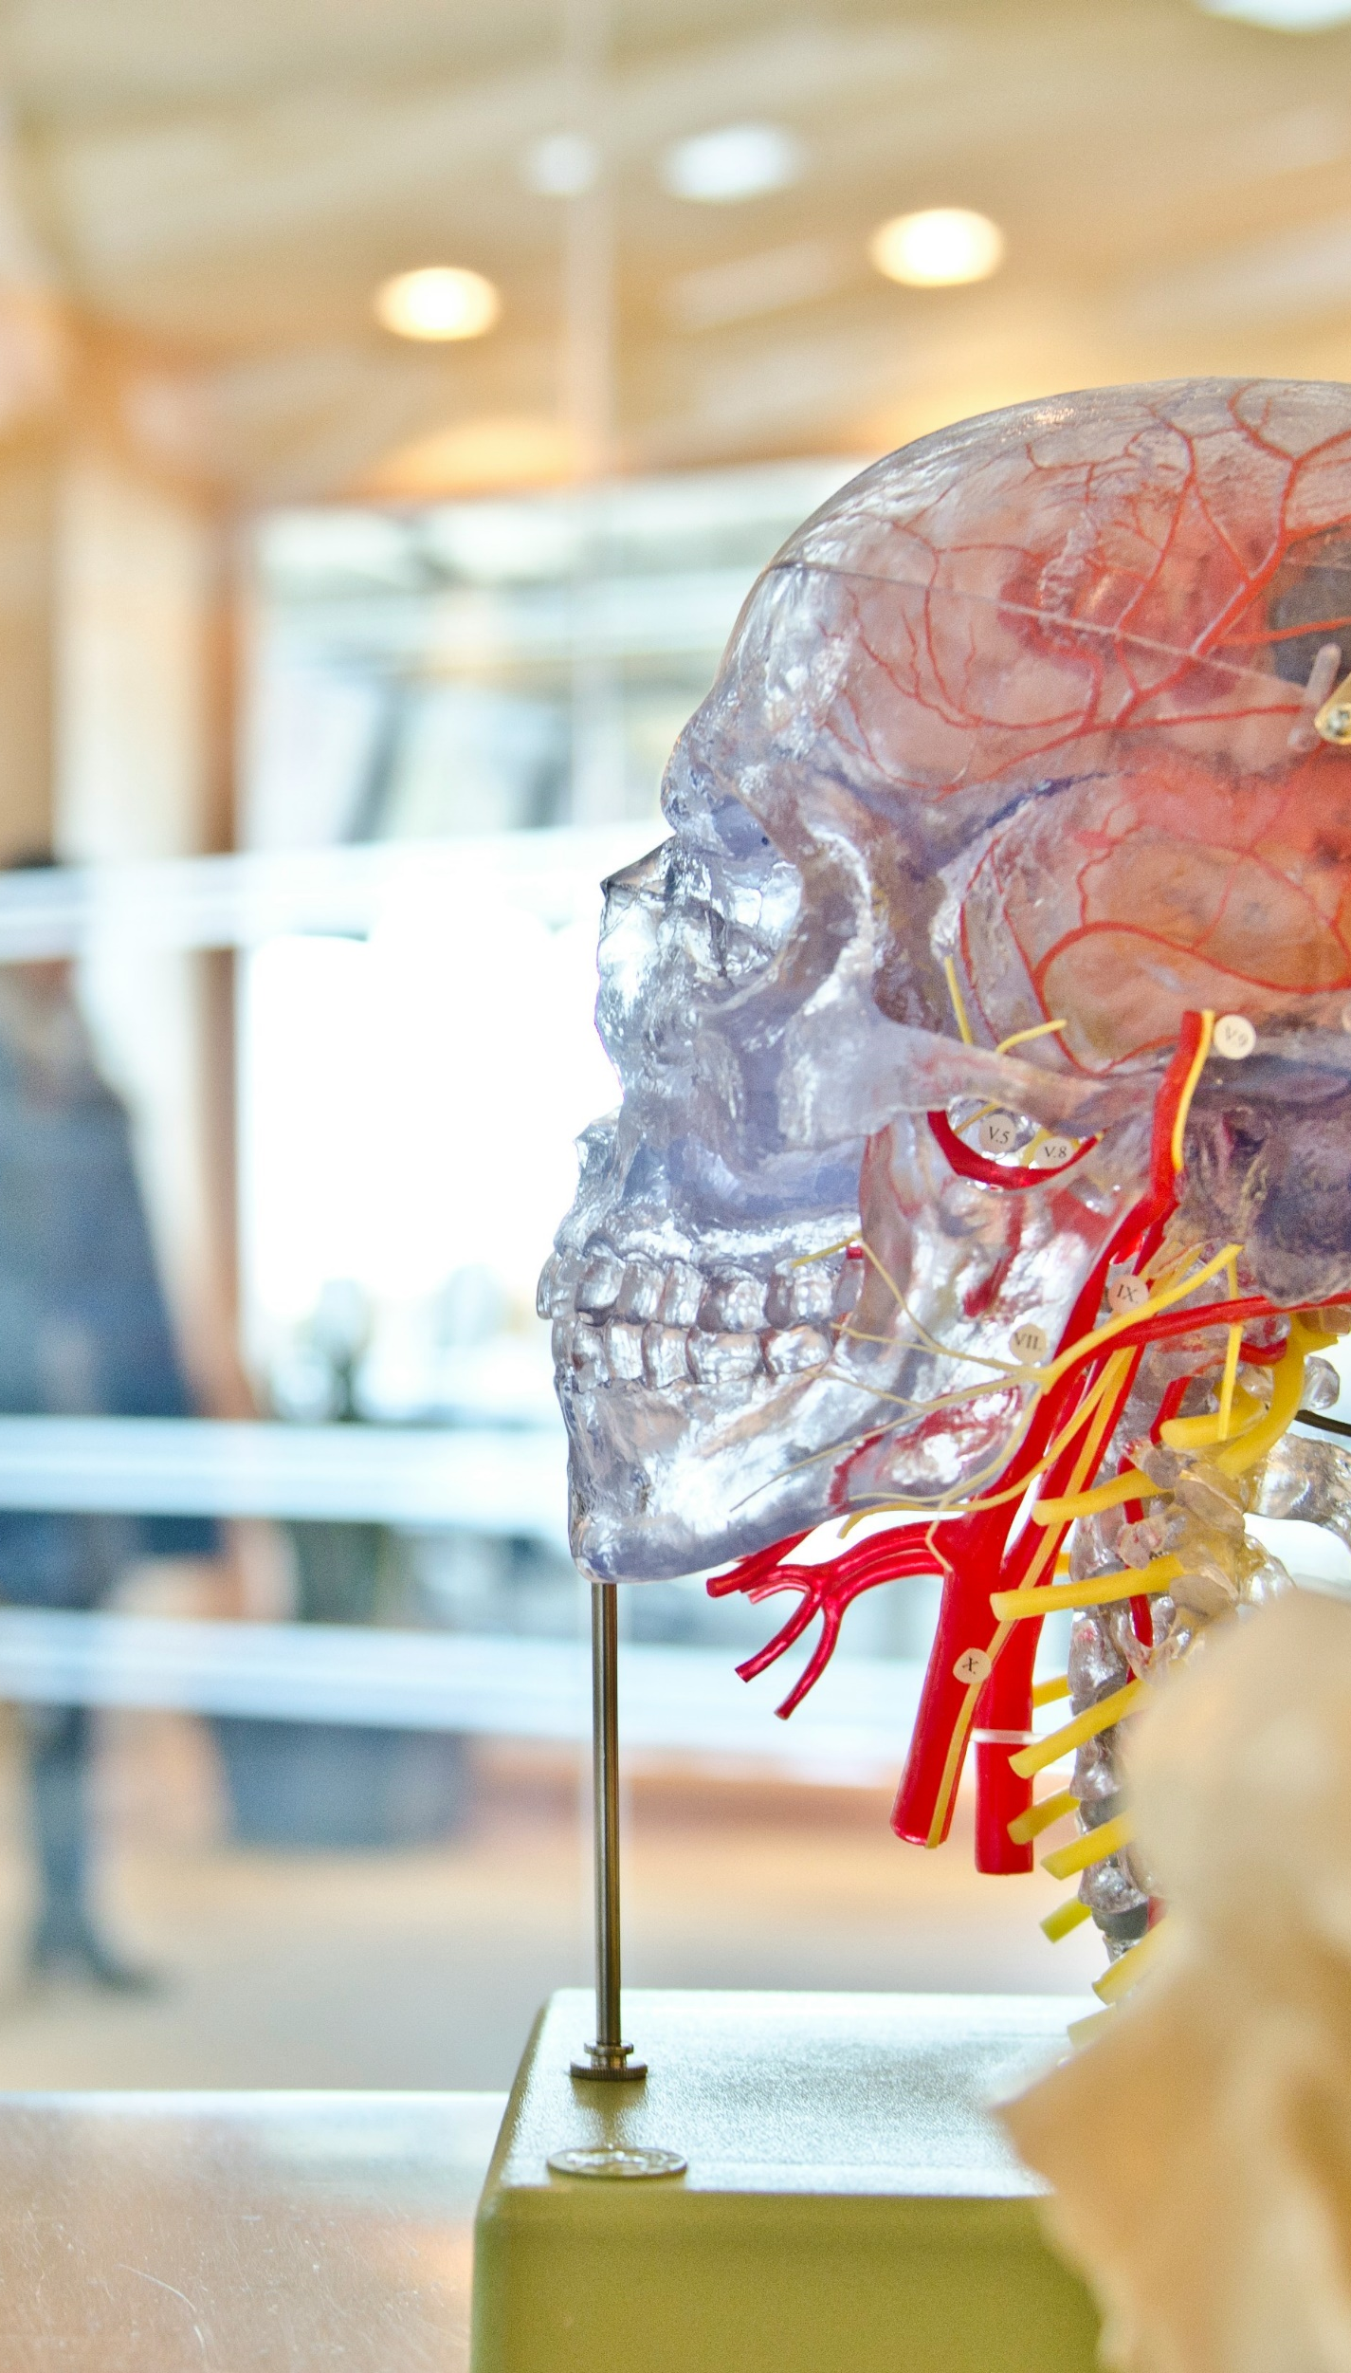
Assessment methods included neurologic and movement exams
Subluxation assessment incorporated neurologic and kinesiologic exam components.
Kwon C, et al. Cureus. 2023 Nov;15(11):e48755
WWW.CHIROONPURPOSE.COM

Slide 18

Evidence-based chiropractic care is emerging
We need more research on the public health value of correcting vertebral subluxation.
Kwon C, et al. Cureus. 2023 Nov;15(11):e48755
WWW.CHIROONPURPOSE.COM

Slide 19

Aligning care with prevention goals
This study supports the need for inclusion of subluxation analysis in wellness-oriented care.
Kwon C, et al. Cureus. 2023 Nov;15(11):e48755
WWW.CHIROONPURPOSE.COM

Slide 20

The authors argue
Chiropractic care may play a larger role in promoting system-wide adaptability.
Kwon C, et al. Cureus. 2023 Nov;15(11):e48755
WWW.CHIROONPURPOSE.COM

