Slide 1



July
2025
www.chiroonpurpose.com

Slide 2



Tiny Birth Fracture Disrupts Feeding and Sleep in Newborn
Over a one and a half month period and 10 chiropractic visits, the infant showed significant improvements, including increased cervical spine range of motion, better feeding, easier bowel movements, and improved sleep quality. The mother no longer experienced mastitis.
Dorough A, Alcantara J. J Pediatr Matern Fam Health Chiropr. 2025 May;2025:29–44
WWW.CHIROONPURPOSE.COM

Slide 3

Chiropractic Support Resolves Breastfeeding Dysfunction
The infant’s breastfeeding was reported to have improved, and the mother no longer experienced mastitis.
Dorough A, Alcantara J. J Pediatr Matern Fam Health Chiropr. 2025 May;2025:29–44
WWW.CHIROONPURPOSE.COM

Slide 4

Maternal Wellness Restored After Chiropractic for Infant
Resolution of the mother’s symptoms of mastitis and subjective reports of improved quality of life were also noted.
Dorough A, Alcantara J. J Pediatr Matern Fam Health Chiropr. 2025 May;2025:29–44.
WWW.CHIROONPURPOSE.COM

Slide 5

Clavicle Fracture and Subluxation Impact Infant Function
The infant had a notable right clavicle fracture with associated muscle hypertonicity and vertebral subluxations affecting cervical and thoracic regions.
Dorough A, Alcantara J. J Pediatr Matern Fam Health Chiropr. 2025 May;2025:29–44.
WWW.CHIROONPURPOSE.COM

Slide 6
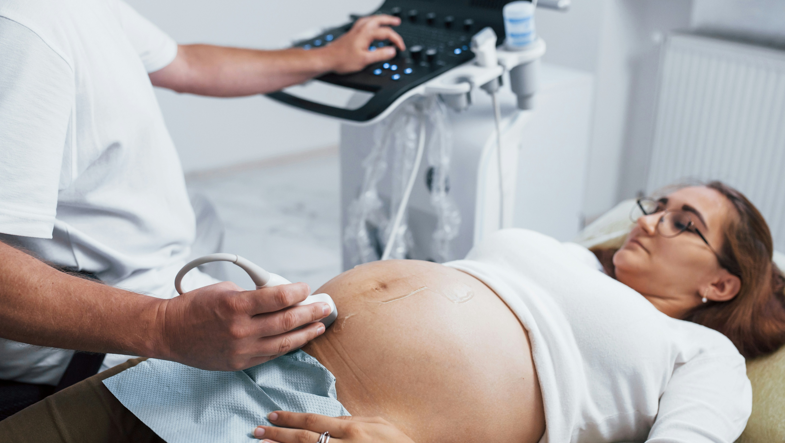
Prenatal Chiropractic and Midwifery Care Turned Breech Baby
At 35 weeks, cephalic positioning was confirmed by both ultrasound and abdominal palpation.
Hosaka K, Alcantara J. J Pediatr Matern Fam Health Chiropr. 2025 Jun;2025:58–69
WWW.CHIROONPURPOSE.COM

Slide 7
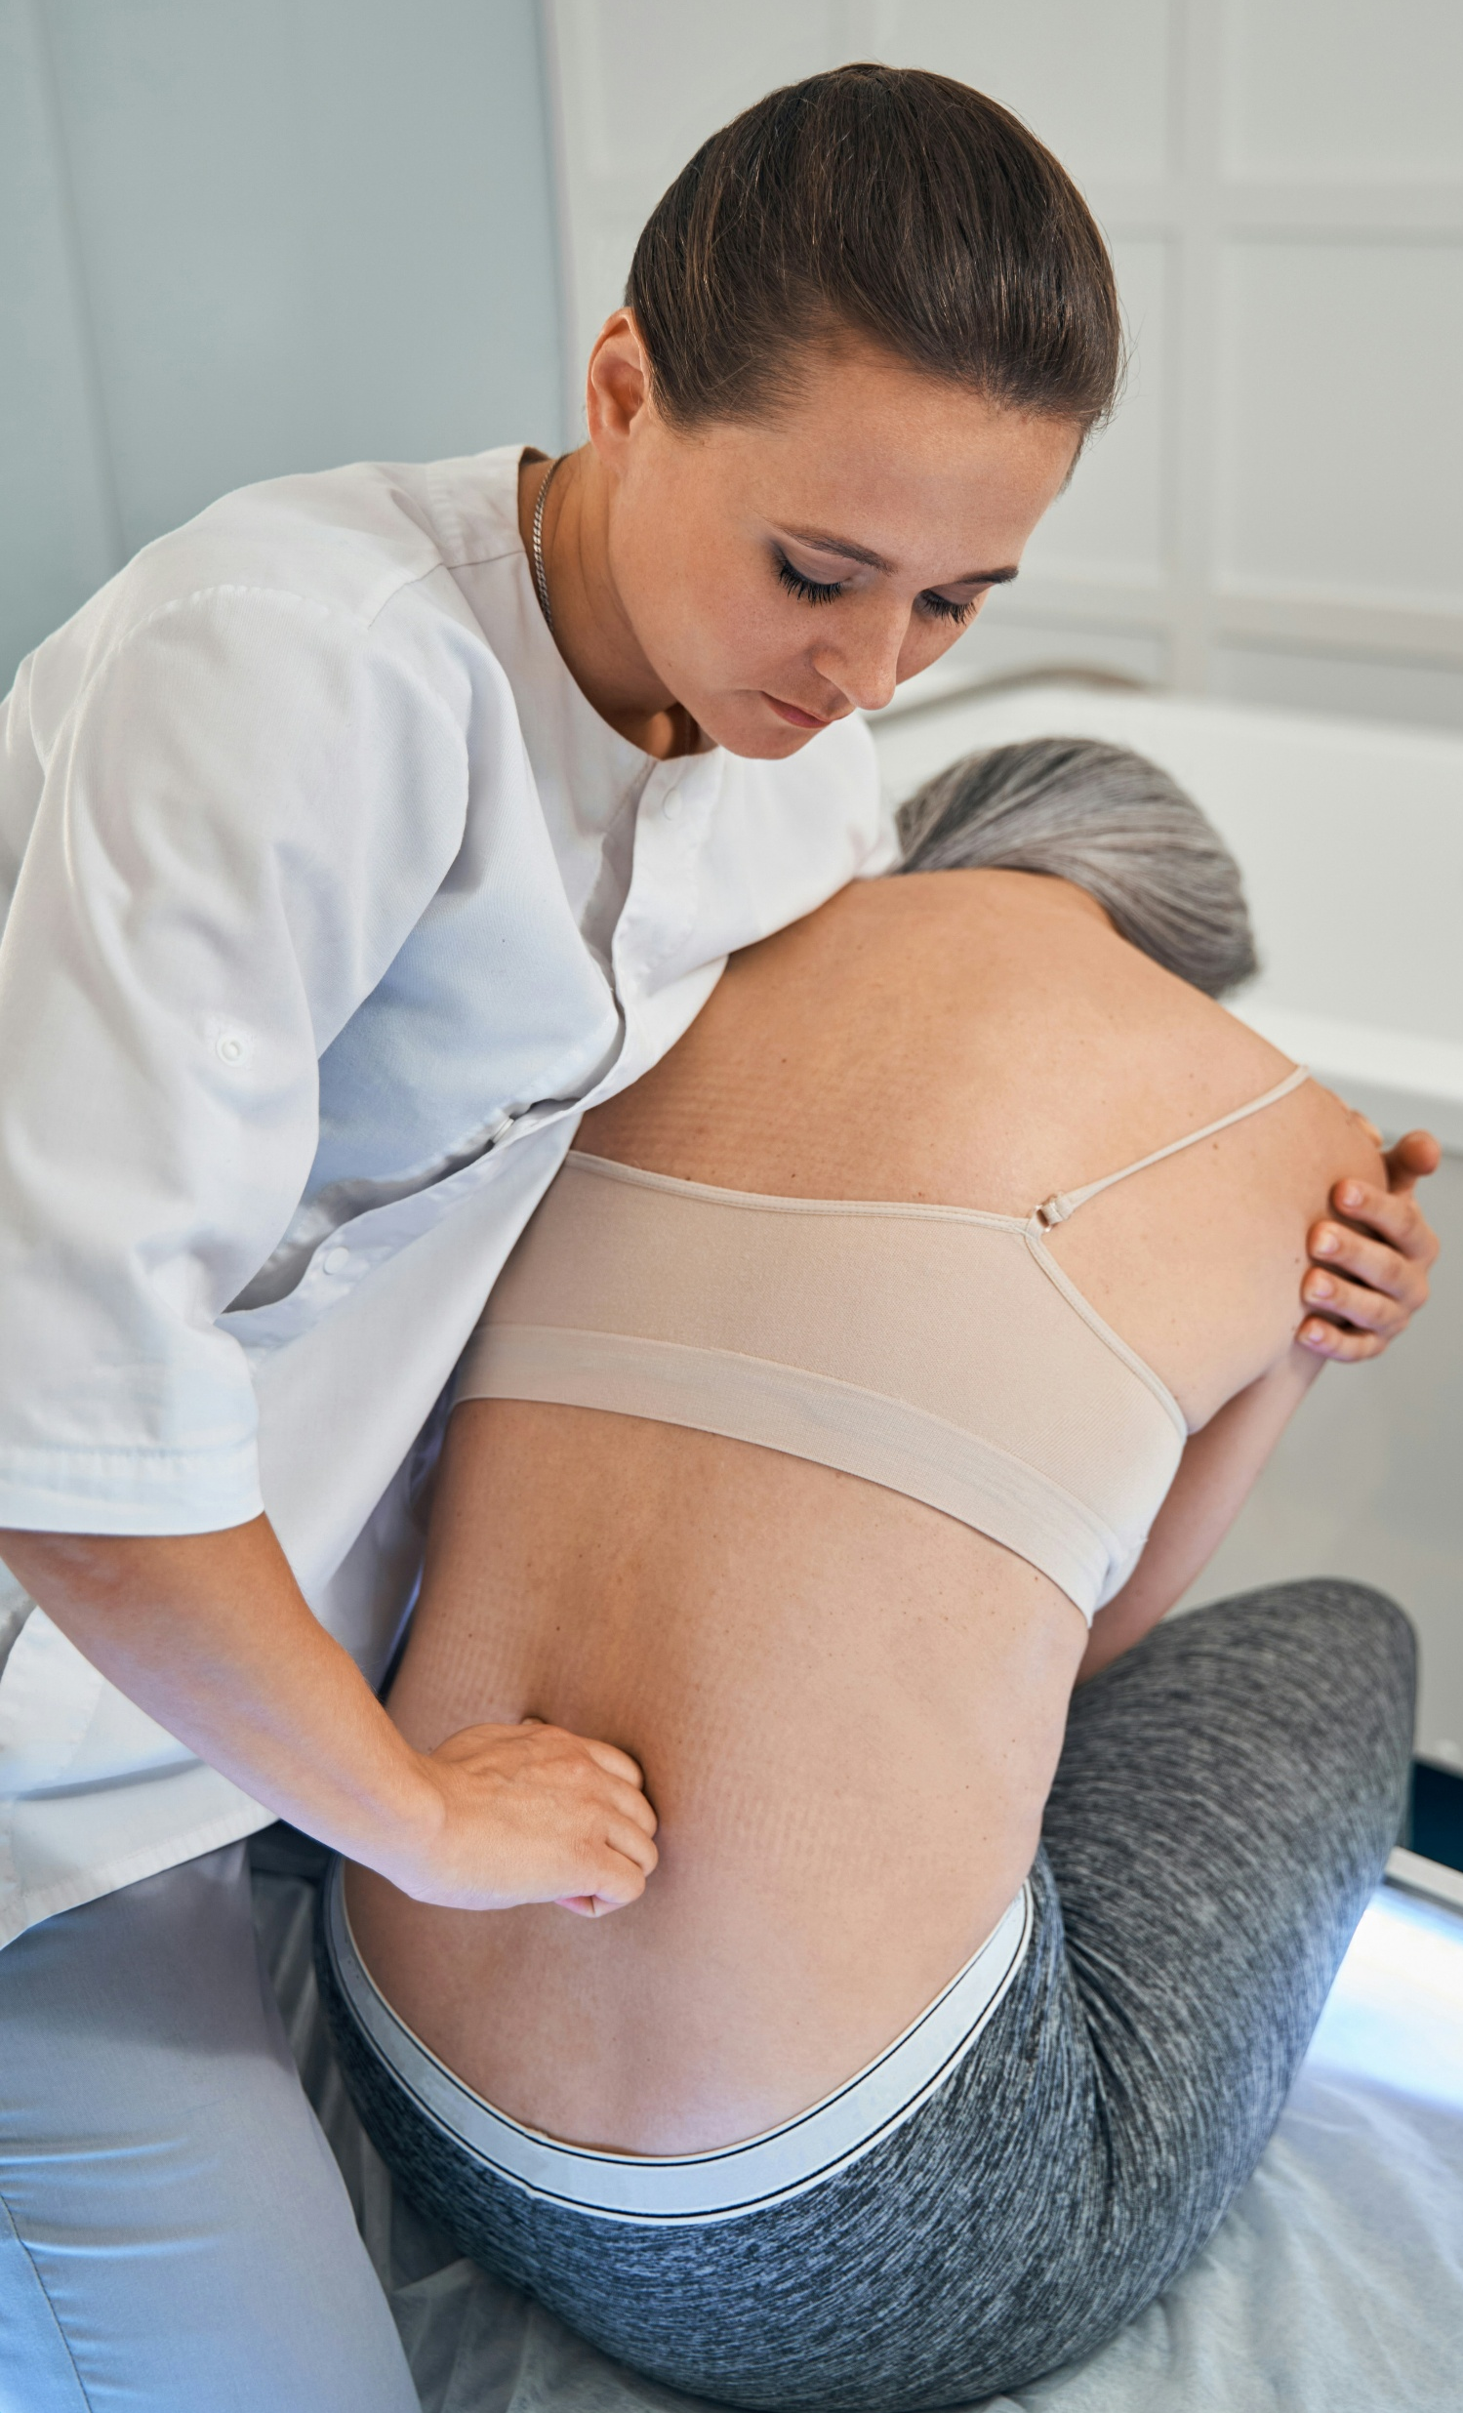
Collaborative Care Overcomes Transverse Lie
Chiropractic adjustments and Webster Technique were utilized alongside midwifery care to resolve transverse lie presentation.
Hosaka K, Alcantara J. J Pediatr Matern Fam Health Chiropr. 2025 Jun;2025:58–69
WWW.CHIROONPURPOSE.COM

Slide 8

Posture Linked to Fibromyalgia Pain Levels
Sagittal imbalance and pelvic obliquity were the strongest predictors of increased scores in the pain, fatigue, and sleep quality outcomes.
Moustafa IM, et al. Sci Rep. 2025 Jul;15:22804
WWW.CHIROONPURPOSE.COM

Slide 9

Spinal Misalignment Affects Sleep and Pain
Cervical sagittal imbalance showed the greatest contribution to increased pain and fatigue indices.
Moustafa IM, et al. Sci Rep. 2025 Jul;15:22804
WWW.CHIROONPURPOSE.COM

Slide 10
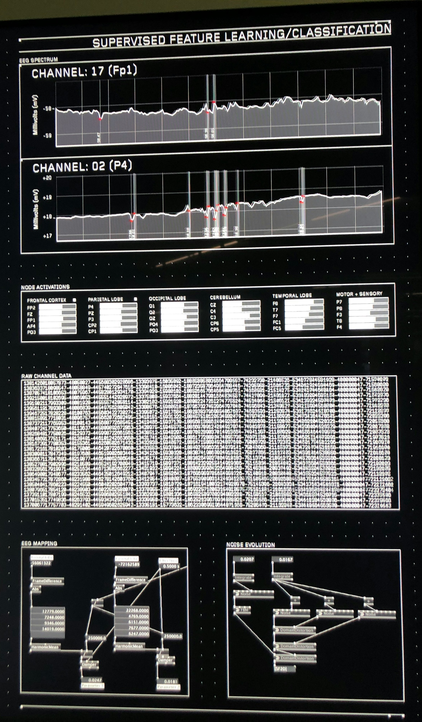
AI Models Accurately Predict Chronic Pain Metrics
FastKAN-BCO model demonstrated the highest R-squared value for algometric pain, while MLP-LBFGS was best for FIQ and PSQI.
Moustafa IM, et al. Sci Rep. 2025 Jul;15:22804
WWW.CHIROONPURPOSE.COM

Slide 11
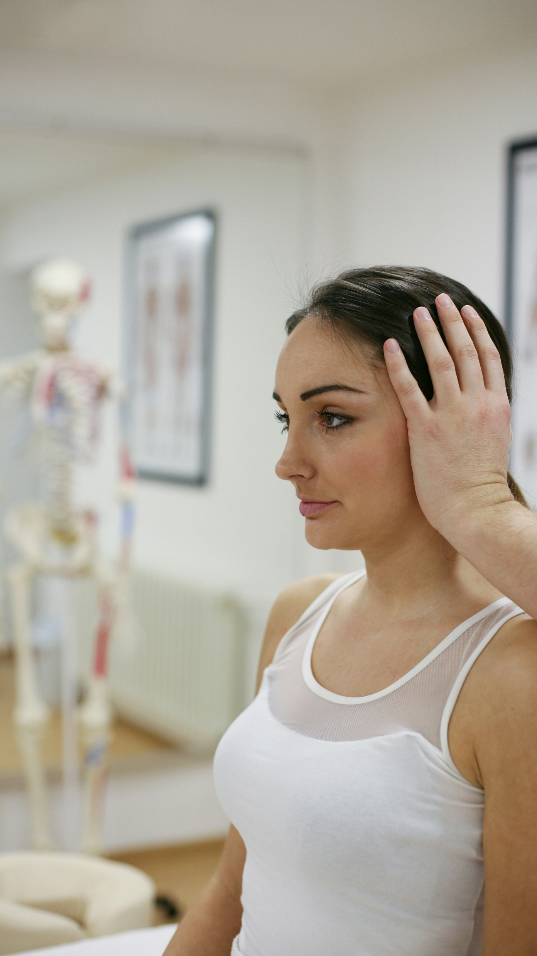
Forward Head Posture Alters Brain-Muscle Communication
Corticomuscular coherence during balance tasks was significantly lower in individuals with forward head posture.
Anwar G, et al. Sci Rep. 2025 Jul;15:22985
WWW.CHIROONPURPOSE.COM

Slide 12

Water Birth Supports Gentle Infant Transition
Water birth was associated with lower odds of severe perineal trauma and neonatal intensive care admission.
McKinney JA, et al. Am J Obstet Gynecol. 2024;230(3):S961–S979.e33
WWW.CHIROONPURPOSE.COM

Slide 13

Water Immersion Linked to Fewer Interventions
Compared to land births, water births were less likely to involve epidural analgesia or instrumental delivery.
McKinney JA, et al. Am J Obstet Gynecol. 2024;230(3):S961–S979.e33
WWW.CHIROONPURPOSE.COM

Slide 14

Water Birth Reduces NICU Admissions
Infants born in water had lower rates of admission to the neonatal intensive care unit (NICU) compared with those born on land.
McKinney JA, et al. Am J Obstet Gynecol. 2024;230(3):S961–S979.e33
WWW.CHIROONPURPOSE.COM

Slide 15

Water Birth Promotes Positive Maternal Outcomes
Water birth was significantly associated with a lower risk of postpartum hemorrhage and severe perineal laceration.
McKinney JA, et al. Am J Obstet Gynecol. 2024;230(3):S961–S979.e33
WWW.CHIROONPURPOSE.COM

Slide 16

Forward Head Posture Impairs Balance Mechanisms
Participants with forward head posture exhibited diminished corticomuscular coherence, indicating disrupted brain–muscle communication during balance control tasks.
Anwar G, et al. Sci Rep. 2025 Jul;15:22985
WWW.CHIROONPURPOSE.COM

Slide 17
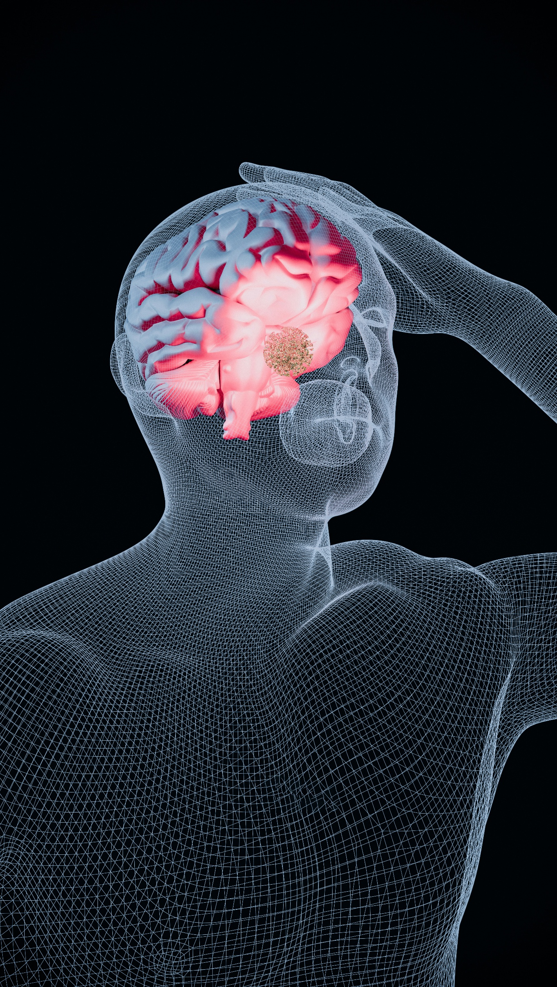
Neuroplasticity Affected by Head Position
Forward head posture appears to influence the cortical control of postural muscles, with possible implications for long-term sensorimotor integration.
Anwar G, et al. Sci Rep. 2025 Jul;15:22985
WWW.CHIROONPURPOSE.COM

Slide 18

AI Reveals Structural Clues to Fibromyalgia Burden
Machine learning models identified pelvic tilt and cervical imbalance as key predictors of pain and sleep disturbance.
Moustafa IM, et al. Sci Rep. 2025 Jul;15:22804
WWW.CHIROONPURPOSE.COM

Slide 19
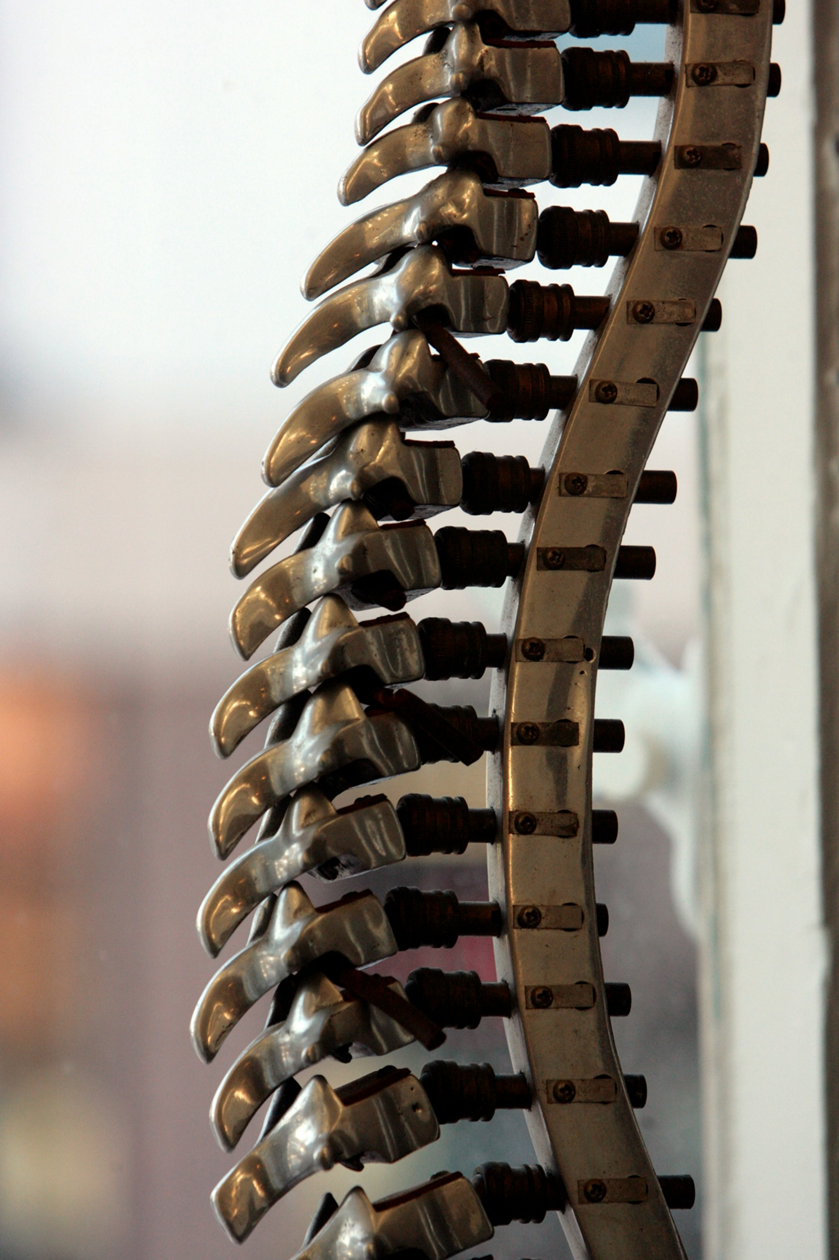
Spinal Posture Metrics Inform AI Pain Models
The findings highlight the potential role of sagittal alignment metrics in developing AI tools for fibromyalgia assessment and management.
Moustafa IM, et al. Sci Rep. 2025 Jul;15:22804
WWW.CHIROONPURPOSE.COM

